Slide 1
Building the Knowledge Hub
When reading faster isn't the answer
A local-first RAG and knowledge graph over a curated Microsoft Fabric & Power BI corpus
Tom Martens Created: 2026-06-19

Slide 2

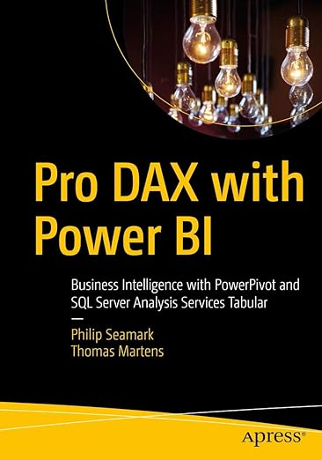

Tom Martens
Solution Architect @ Munich Re (and a little bit of free lancing)
29 years of experience designing analytical solutions using the Microsoft data platform
/tommartens68
@tommartens68
2

Slide 3
Reading faster isn't the answer
The bottleneck was never finding articles
The field moves faster than anyone can read. New posts every day, from people worth reading.
Speed-reading more doesn't fix it — it just moves the overwhelm around.
The real bottleneck is digesting: connecting what I read across hundreds of articles.
I didn't need help finding. I needed help digesting.
~7,000
curated articles, and counting
from a handful of authors I trust — not the whole internet
2

Slide 4
A curated corpus, not an archive
The corpus reflects a deliberate choice of who to trust
Who's in it
Curation is the point
Chris Webb
It's not an encyclopedia. It mirrors a defend-and-grow map of the topics I rely on.
learn.microsoft.com is the law; community blogs are commentary.
The quality of the corpus sets the ceiling on every answer the hub can give.
Meagan Longoria
Nikola Ilić
Sandeep Pawar
Kurt Buhler
Gilbert Quevauvilliers
Raki Rahman
Microsoft Fabric & Power BI blogs
3

Slide 5
Where it all lives: Obsidian
The corpus is plain markdown in a vault I already think in
Every article is a plain-markdown note in an Obsidian vault.
I read and write markdown in Obsidian every day — so the corpus lives in the tool I already use to think and write.
No proprietary store, no lock-in. Just files on disk, synced — the vault is the source of truth.
M
Why markdown + Obsidian
Human-readable and future-proof — readable in any editor, 10 years from now
Frontmatter carries provenance: source, author, date
Everything downstream — vectors, graph — is rebuildable from these files
4

Slide 6
Two ways to reach an answer
Two retrieval surfaces, two different questions
≈
Vector search
∞
Knowledge graph
“What is this about?”
“What connects to what?”
Meaning-based similarity
Finds articles close in meaning to your question
Entities and the relationships between them
Reaches across articles to surface connections
They're complementary — neither alone is enough. The rest of the talk shows why.
5

Slide 7
The foundation: vector search
Turning meaning into geometry
An embedding turns an article into a point in a high-dimensional space.
Nearby points mean similar meaning — not similar words.
A question becomes a point too. Retrieval is simply: what's nearest?
≈
Why the model matters
Nomic embeddings read 8K tokens — full articles, not just the first paragraph
Deterministic: same text always maps to the same point
The embedding-model choice matters more than most people realise
6

Slide 8
Where vector search hits its ceiling
Similarity is powerful — until the question is about relationships
The ceiling
LIVE DEMO
Similarity is not relationship. Vector search finds articles about a topic — it can't tell you how two concepts connect across articles.
Vocabulary mismatch: “dax” vs “DAX”; a reframing article that never uses your words is invisible to it.
That ceiling is exactly what motivates the graph layer.
Semantic search over the corpus
vault_indexer.py \
--query "Direct Lake guardrails"
Ask in plain language; get the nearest articles back, ranked.
7

Slide 9
The graph layer: entities & relationships
What a knowledge graph represents that a vector store can't
●
Entities
∞
Relationships
The named things: Direct Lake, calculation groups, semantic models, Tabular Editor.
How they connect: “X depends on Y”, “A is an alternative to B”.
⇄
Cross-article bridges
?
Why it matters
A connection the corpus only implies — stated nowhere, spread across several posts.
Answers relationship-shaped questions a vector store structurally cannot reach.
8

Slide 10
How the graph gets built
Local extraction, merged into one growing graph
1
Read each article
straight from the Obsidian vault
✓
Scales down
2
Extract entities & relationships
Extraction is compute-heavy — minutes per article. The design assumes compute is scarce.
Gemma 3 27B, running locally via Ollama
3
Merge into one graph
LightRAG unifies entities across articles
It runs on a modest laptop. It just runs slower.
4
Batch-and-resume
bounded batches; stop and resume any time
9

Slide 11
Two models — right tool per job
Embedding and extraction are different tasks, so they use different models
≈
Nomic — the embedding model
⚙
Gemma 3 27B — the extraction model
Turns each article into a vector — meaning as geometry, for similarity search.
Deterministic: the same text always returns the exact same vector.
Small and CPU-friendly — nomic-embed-text v1.5, 768 dimensions, 8K tokens.
Reads articles and pulls out the entities and relationships that form the graph.
A large generative model — heavier, and runs locally through Ollama.
Stochastic: re-running samples again rather than converging on one truth.
Building the Knowledge Hub · Data TGIF

Slide 12
Live: exploring the knowledge graph
Starting the LightRAG server and opening the graph in the browser
The graph, made visible
LIVE DEMO
Entities as nodes, relationships as edges — the structure Gemma extracted, laid out in the browser.
≈66,000 entities and ≈84,000 relationships across ≈7,000 articles.
Click an entity to walk its neighbours — the same traversal the retrieve tool makes.
The LightRAG server + Web UI
conda activate lightrag-server
cd ~/knowledgehub-lightrag
lightrag-server
Read-only. Opens at http://127.0.0.1:9621
10

Slide 13
Vector and graph are complementary
Tested side by side on the full corpus — neither dominates
Vector (ChromaDB)
Graph (LightRAG)
Strength
operational specifics
concepts + relationships
Finds
“what does X say about Y”
“what connects X and Y”
Misses
how concepts relate
sharp one-off details
!
The finding
One real architecture question, run through both. Each surfaced articles the other missed — and feeding the graph's context to the companion added three Fabric-specific considerations the model didn't reach on its own.
11

Slide 14
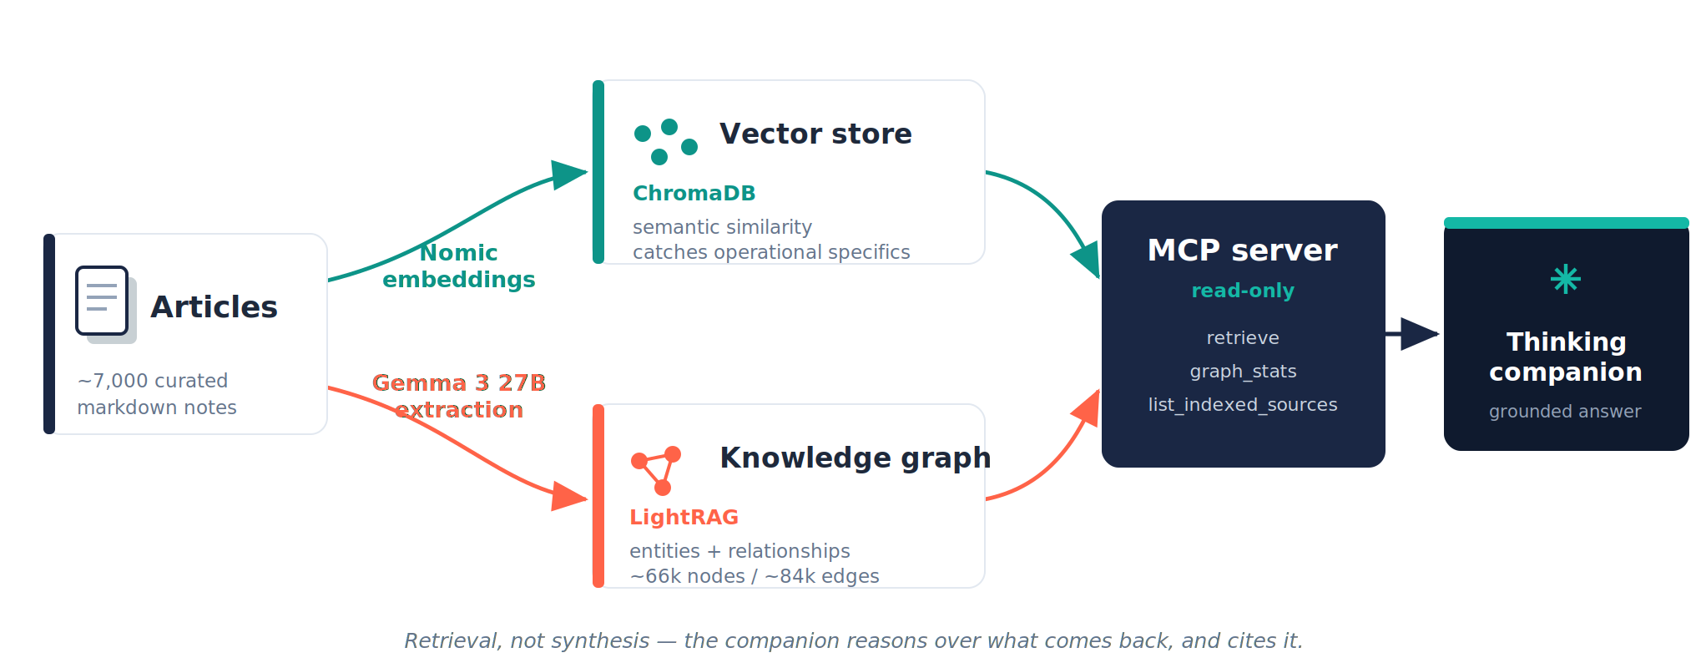
The architecture, end to end
Articles → two indexers → MCP → thinking companion
12

Slide 15
The bridge: a read-only MCP server
From a manual terminal step to a native tool call
Retrieval used to be manual: run a query in the terminal, paste the context into the chat.
The MCP server makes retrieval a native tool call the companion can make itself.
It only retrieves; the companion synthesises. Purely local — no cloud, no secrets.
Three read-only tools
retrieve
graph context + the articles the graph didn't reference — the value is the subtraction
graph_stats
entity / relationship / article counts
list_indexed_sources
per-source article tally
13

Slide 16
Live: retrieval as a native tool call
The MCP server inside Claude Desktop — no terminal, no paste
From script to native
LIVE DEMO
Before: run lightrag_query.py in a terminal, copy the context, paste it into the chat.
Now: Claude calls retrieve itself — graph context plus the articles the graph didn't reference.
Or watch it in the browser: the server's Retrieval tab does the same retrieval, no script.
The MCP only retrieves; the companion does the reasoning.
Ask in Claude Desktop
“What should I consider for
Direct Lake guardrails?”
→ Claude calls retrieve()
The tool runs locally; Claude synthesises and cites.
14

Slide 17
Why Opus 4.8 does the answering
Match the model's capability to the question's complexity
★
Capability matches complexity
!
The honest edge
The harder the question, the more capable the model should be.
Synthesising across the grounded corpus — conflicting sources, trade-offs — is the hard part. That's Opus 4.8's job.
A simple lookup, like a visual's property name, wouldn't need that depth.
If Haiku 4.5 could answer it, a plain web search probably could too.
So the hub doesn't earn its keep on trivia — it earns it on the hard, synthesis-heavy questions.
Match the model to the task; don't pay for capability the question doesn't need.
Building the Knowledge Hub · Data TGIF

Slide 18
Keeping it honest
The hub adds grounding — it doesn't make the model infallible
!
Error laundering
=
Both layers stay on
A confident answer over a wrong retrieval is still wrong. Grounding is not the same as truth.
Vector and graph run in parallel — each covers the other's blind spot.
+
Grounding vs intelligence
~
Stochastic extraction
The model was never dumb without the corpus. The corpus adds citable, dated sources — equal partners.
Re-running Gemma doesn't approach truth — it samples again. A known, named limit.
15

Slide 19
The next note type: the question
Obsidian's link system is an ideal home for the questions, too
Today the vault stores articles. The natural next step is to store the questions.
Each question becomes a markdown note that links — Obsidian-style — to the articles and entities it touched.
Over time those links become a second, human-curated layer over the machine-extracted graph.
[[
Why Obsidian links fit
A question note links to its sources, so the answer's provenance is built in
Questions interlink with each other and with articles
The store of questions is itself a knowledge graph
16

Slide 20
What's next
Where the Knowledge Hub is heading
⇄
Merge, don't rebuild
Fold “DirectLake” / “Direct lake” into one entity via the LightRAG API — incrementally, no full rebuild
⚙
PostgreSQL as the curation lens
Query the substrate to spot fragmentation — one entity spelled three ways — and flag what needs merging
★
Author trust levels
Per-author, per-topic weighting that influences how conflicting sources are synthesised
◆
A path to Fabric
Same extraction substrate, landed as Delta tables — a graph colleagues can query
?
Questions as a corpus
The store of questions becomes a first-class, linkable part of the vault
17

Slide 21
Curate, don't accumulate
The win isn't more articles. It's a corpus worth reasoning over — and a companion that reasons over it honestly, and cites its sources.
Your corpus × 10: imagine your own trusted sources, structured this way.
18

Slide 22
It takes both — and who's accountable
The hub grounds, the companion reasons — and the decision stays mine
=
Why it needs both
!
The accountability is mine
The hub without a companion is a better search box. The companion without the hub is fluent but ungrounded.
Grounding supplies dated, citable sources; reasoning turns them into an answer.
Equal partners — neither alone is enough.
The companion helps with the reading AND the reasoning; I decide, and I own the outcome.
Provision an F2048 today and find six months on that an F32 would have done? That's on me — not the companion's fault.
Grounding sharpens the call. It doesn't transfer the responsibility.
19

Slide 23
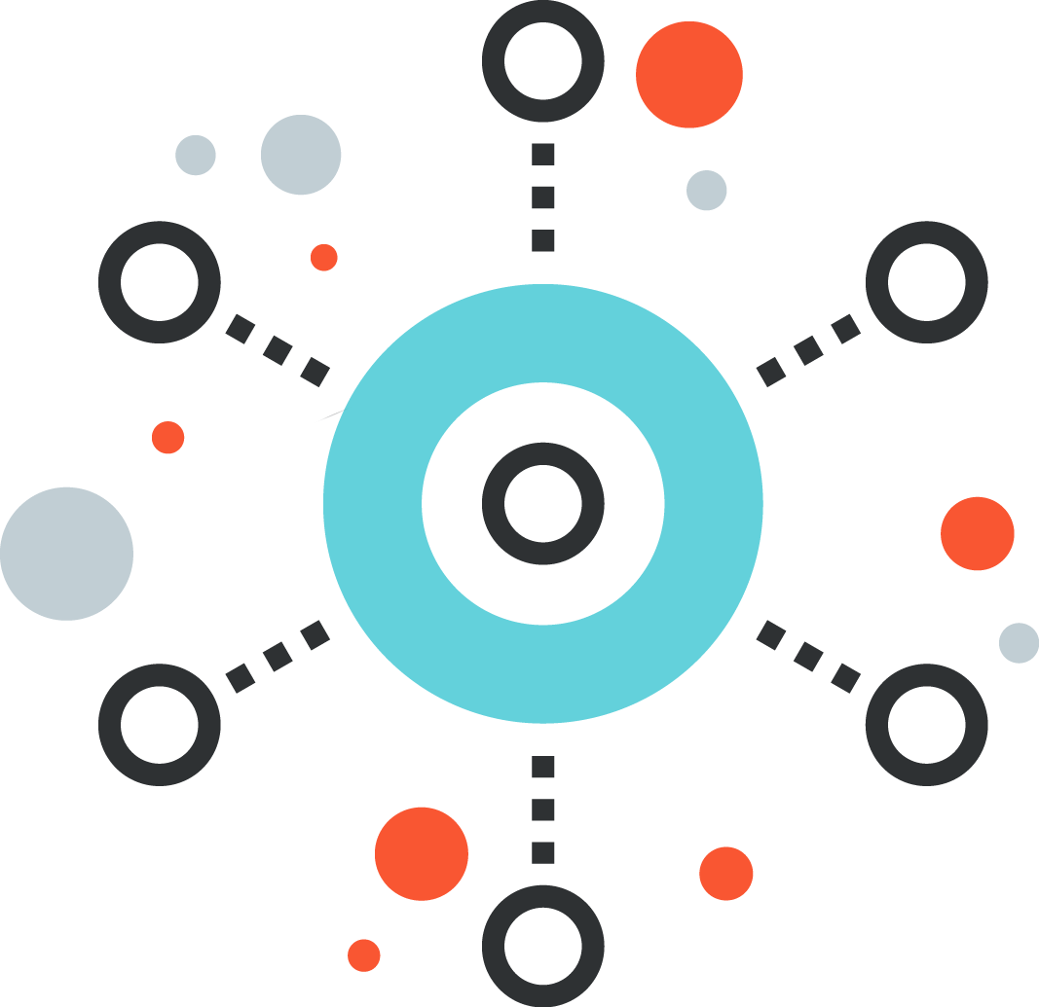

Additional resources
More readings- more mfun
⇄
minceddata.net
My blog, with a growing series of the knowledge hub: https://minceddata.net/The+knowledge+hub/Building+a+Personal+Knowledge+Hub
Github repo
My public repo that helps to get you started with rss-based articles:
https://github.com/tomatminceddata/RSS-feed-sync
Glossary

Slide 24
Thank you
Questions & live demo
minceddata.net — the “Knowledge Hub” series
Find me on LinkedIn
Thanks to Kay Sauter & the Data TGIF community

Slide 25
Glossary — the retrieval side
The ideas behind the rabbit holes — none of it Fabric-specific
⇄
Embedding
Text turned into a list of numbers that captures its meaning, so similar ideas sit close together in space.
⚙
Tokens & context window
The word-pieces a model reads, and how many it takes in at once — the hub’s embedder handles about 8K.
★
Vector store
A database that holds embeddings and finds the nearest ones to a query fast. ChromaDB plays this role here.
◆
Semantic similarity
Closeness in meaning rather than wording — so “DAX” and “calculation language” can match with no shared words.
?
RAG
Retrieval-Augmented Generation: fetch relevant text first, then answer from it — grounding the answer in sources.
Glossary

Slide 26
Glossary — graphs, models & glue
How the pieces connect — still nothing Power BI-specific
⇄
Knowledge graph
A network of facts: things connected by relationships, capturing how concepts link, not just what one article says.
⚙
Entity
A named thing pulled from the text — a feature, person, product or concept. These are the nodes of the graph.
★
Relationship (edge)
A connection between two entities — “X depends on Y,” “A is an alternative to B.” The lines of the graph.
◆
LLM
Large Language Model — reads and writes language; here it extracts entities and reasons over what’s retrieved.
?
MCP
Model Context Protocol — an open standard for a model to call external tools uniformly; the hub exposes retrieval as one.
Glossary

Slide 27
A few common mix-ups
MCP vs. agent, and where the Copilot brand fits
⇄
MCP is not an agent
An MCP server only exposes tools over a standard protocol; it decides nothing. The agent is what calls those tools to reach a goal — here, the companion.
★
Copilot is a brand
Not one product — it’s Microsoft’s umbrella name across M365, GitHub, Power BI and more. It tells you the family, not the specific tool.
?
Claude Desktop ≈ Copilot Studio
A loose analogy: both are where you wire a model up to tools and data. MCP servers play the role connectors and actions do in Copilot Studio.
Glossary

